Slide 1


1: Introduction to Data Analysis

Slide 2

Introduction to Data Analysis
The following topics will be covered in this lesson:
The fundamentals of data analysis
Statistical foundations
Notes:
We need to learn about the fundamentals of data analysis. Those who have ever looked at the documentation for a software library know how overwhelming it can be if you have no clue what you are looking for. Therefore, it is essential that we master not only the coding aspect but also the thought process and workflow required to analyze data, which will prove the most useful in augmenting our skill set in the future.
Much like the scientific method, data science has some common workflows that we can follow when we want to conduct an analysis and present the results. The backbone of this process is statistics, which gives us ways to describe our data, make predictions, and also draw conclusions about it. Since prior knowledge of statistics is not a prerequisite, this lesson will give us exposure to the statistical concepts we will use throughout this course, as well as areas for further exploration.
After covering the fundamentals, we will get our Python environment set up for the remainder of this course. Python is a powerful language, and its uses go way beyond data science: building web applications, software, and web scraping, to name a few. In order to work effectively across projects, we need to learn how to make virtual environments, which will isolate each project's dependencies. Finally, we will learn how to work with Jupyter Notebooks in order to follow along with the text.

Slide 3

lesson materials
In order to get a local copy of the files, we have a few options (ordered from least useful to most useful):
Download the ZIP file and extract the files locally.
Clone the repository without forking it.
Fork the repository and then clone it.
Notes:
All the files for this course are on GitHub at https://github.com/fenago/data-analysis-pandas While having a GitHub account isn't necessary to work through this course, it is a good idea to create one, as it will serve as a portfolio for any data/coding projects. In addition, working with Git will provide a version control system and make collaboration easy.
This course includes exercises for every lesson; therefore, for those who want to keep a copy of their solutions along with the original content on GitHub, it is highly recommended to fork the repository and clone the forked version. When we fork a repository, GitHub will make a repository under our own profile with the latest version of the original. Then, whenever we make changes to our version, we can push the changes back up. Note that if we simply clone, we don't get this benefit.

Slide 4
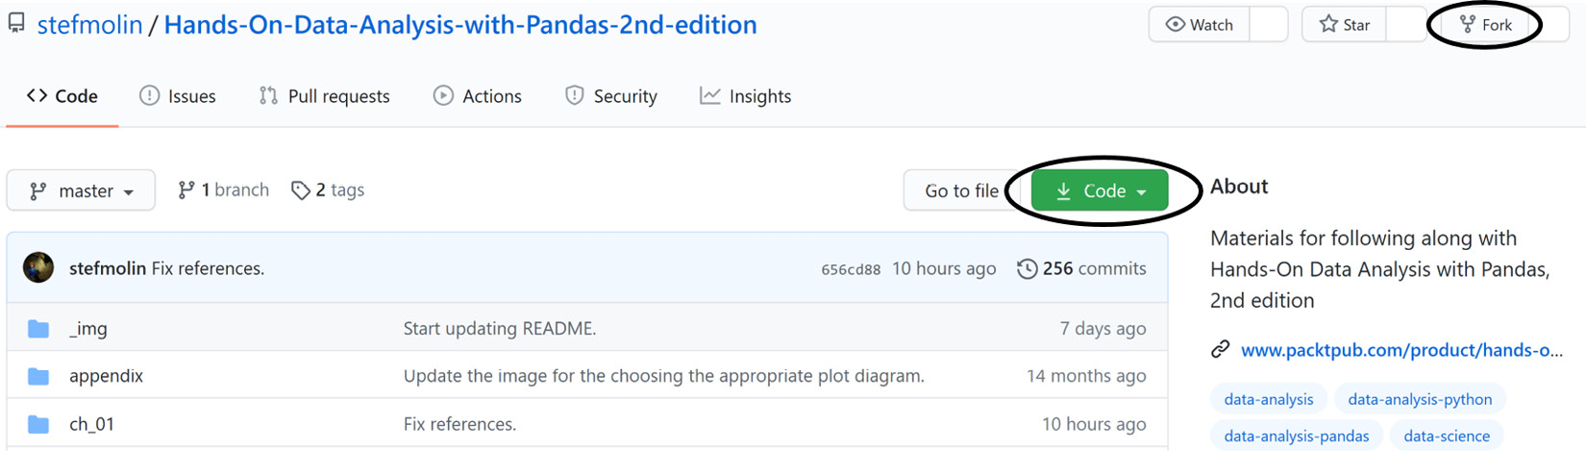
lesson materials
The relevant buttons for initiating this process are circled in the following screenshot:
Notes:
Important note
The cloning process will copy the files to the current working directory in a folder. To make a folder to put this repository in, we can use mkdir my_folder && cd my_folder. This will create a new folder (directory) called my_folder and then change the current directory to that folder, after which we can clone the repository. We can chain these two commands (and any number of commands) together by adding && in between them. This can be thought of as and then (provided the first command succeeds).
This repository has folders for each lesson. This lesson's materials can be found at https://github.com/fenago. While the bulk of this lesson doesn't involve any coding, feel free to follow along in the introduction_to_data_analysis.ipynb notebook on the GitHub website until we set up our environment toward the end of the lesson. After we do so, we will use the check_your_environment.ipynb notebook to get familiar with Jupyter Notebooks and to run some checks to make sure that everything is set up properly for the rest of this course.
Since the code that's used to generate the content in these notebooks is not the main focus of this lesson, the majority of it has been separated into the visual_aids package, which is used to create visuals for explaining concepts throughout the course, and the check_environment.py file. If you choose to inspect these files, don't be overwhelmed; everything that's relevant to data science will be covered in this course.
Every lesson includes exercises; however, for this lesson only, there is an exercises.ipynb notebook, with code to generate some initial data. Knowledge of basic Python will be necessary to complete these exercises. For those who would like to review the basics, make sure to run through the python_101.ipynb notebook, included in the materials for this lesson, for a crash course. The official Python tutorial is a good place to start for a more formal introduction: https://docs.python.org/3/tutorial/index.html.

Slide 5
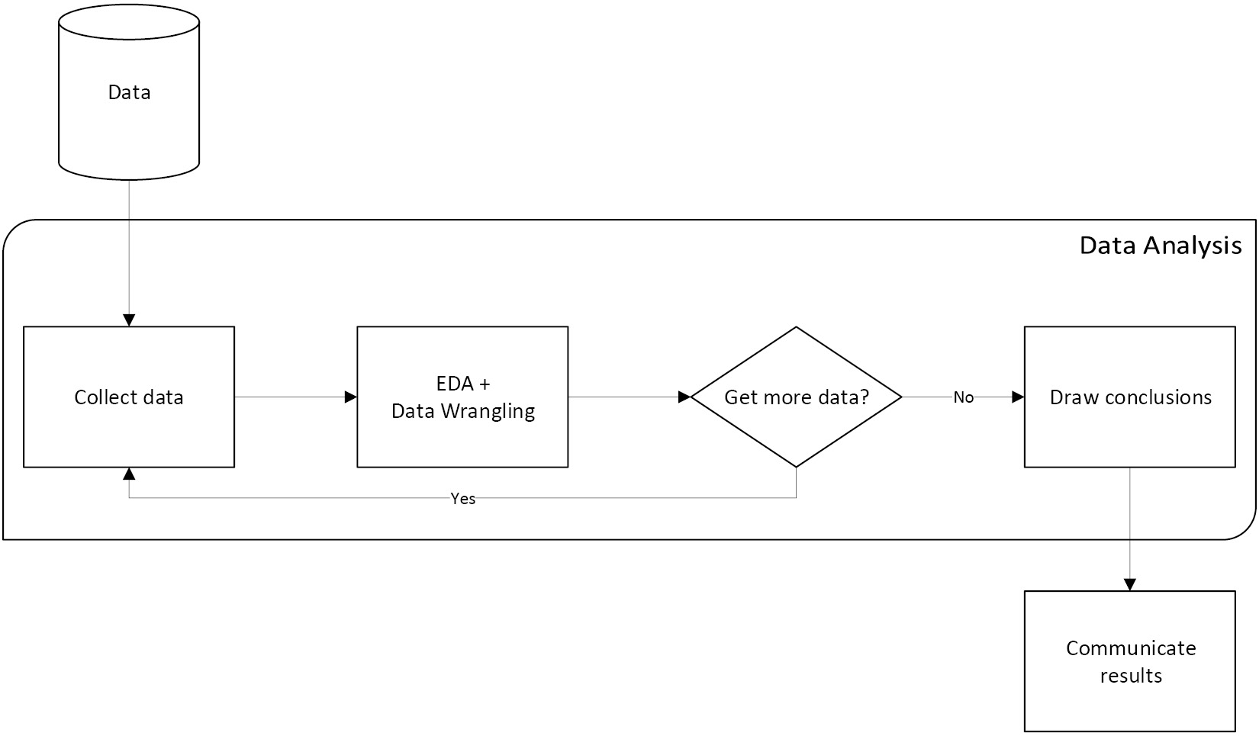
The fundamentals of data analysis
The following diagram depicts a generalized workflow:
Notes:
Data analysis is a highly iterative process involving collection, preparation (wrangling), exploratory data analysis (EDA), and drawing conclusions.
During an analysis, we will frequently revisit each of these steps.
Over the next few sections, we will get an overview of each of these steps, starting with data collection. In practice, this process is heavily skewed toward the data preparation side. Surveys have found that although data scientists enjoy the data preparation side of their job the least, it makes up 80% of their work (https://www.forbes.com/sites/gilpress/2016/03/23/data-preparation-most-time-consuming-least-enjoyable-data-science-task-survey-says/). This data preparation step is where pandas really shines.
Data collection is the natural first step for any data analysis—we can't analyze data we don't have.
In reality, our analysis can begin even before we have the data.
When we decide what we want to investigate or analyze, we have to think about what kind of data we can collect that will be useful for our analysis.
Data wrangling is the process of preparing the data and getting it into a format that can be used for analysis.
The unfortunate reality of data is that it is often dirty, meaning that it requires cleaning (preparation) before it can be used.
The following are some issues we may encounter with our data:
Human errors: Data is recorded (or even collected) incorrectly, such as putting 100 instead of 1000, or typos. In addition, there may be multiple versions of the same entry recorded, such as New York City, NYC, and nyc.
Computer error: Perhaps we weren't recording entries for a while (missing data).
Unexpected values: Maybe whoever was recording the data decided to use a question mark for a missing value in a numeric column, so now all the entries in the column will be treated as text instead of numeric values.
Incomplete information: Think of a survey with optional questions; not everyone will answer them, so we will have missing data, but not due to computer or human error.
Resolution: The data may have been collected per second, while we need hourly data for our analysis.
Relevance of the fields: Often, data is collected or generated as a product of some process rather than explicitly for our analysis. In order to get it to a usable state, we will have to clean it up.
Format of the data: Data may be recorded in a format that isn't conducive to analysis, which will require us to reshape it.
Misconfigurations in the data-recording process: Data coming from sources such as misconfigured trackers and/or webhooks may be missing fields or passed in the wrong order.
Most of these data quality issues can be remedied, but some cannot, such as when the data is collected daily and we need it on an hourly resolution. It is our responsibility to carefully examine our data and handle any issues so that our analysis doesn't get distorted. We will cover this process in depth in lesson 3, Data Wrangling with Pandas, and lesson 4, Aggregating Pandas DataFrames.
Once we have performed an initial cleaning of the data, we are ready for EDA. Note that during EDA, we may need some additional data wrangling: these two steps are highly intertwined.

Slide 6
Exploratory data analysis
EDA and data wrangling shared a box. This is because they are closely tied:
Data needs to be prepped before EDA.
Visualizations that are created during EDA may indicate the need for additional data cleaning.
Data wrangling uses summary statistics to look for potential data issues, while EDA uses them to understand the data.
Notes:
During EDA, we use visualizations and summary statistics to get a better understanding of the data. Since the human brain excels at picking out visual patterns, data visualization is essential to any analysis. In fact, some characteristics of the data can only be observed in a plot. Depending on our data, we may create plots to see how a variable of interest has evolved over time, compare how many observations belong to each category, find outliers, look at distributions of continuous and discrete variables, and much more.
Important note
Data visualizations are very powerful; unfortunately, they can often be misleading. One common issue stems from the scale of the y-axis because most plotting tools will zoom in by default to show the pattern up close. It would be difficult for software to know what the appropriate axis limits are for every possible plot; therefore, it is our job to properly adjust the axes before presenting our results. You can read about some more ways that plots can be misleading at https://venngage.com/blog/misleading-graphs/.
Improper cleaning will distort the findings when we're conducting EDA.
In addition, data wrangling skills will be required to get summary statistics across subsets of the data.
When calculating summary statistics, we must keep the type of data we collected in mind. Data can be quantitative (measurable quantities) or categorical (descriptions, groupings, or categories). Within these classes of data, we have further subdivisions that let us know what types of operations we can perform on them.
For example, categorical data can be nominal, where we assign a numeric value to each level of the category, such as on = 1/off = 0. Note that the fact that on is greater than off is meaningless because we arbitrarily chose those numbers to represent the states on and off. When there is a ranking among the categories, they are ordinal, meaning that we can order the levels (for instance, we can have low < medium < high).
Quantitative data can use an interval scale or a ratio scale. The interval scale includes things such as temperature. We can measure temperatures in Celsius and compare the temperatures of two cities, but it doesn't mean anything to say one city is twice as hot as the other. Therefore, interval scale values can be meaningfully compared using addition/subtraction, but not multiplication/division. The ratio scale, then, are those values that can be meaningfully compared with ratios (using multiplication and division). Examples of the ratio scale include prices, sizes, and counts.
When we complete our EDA, we can decide on the next steps by drawing conclusions.

Slide 7


Drawing conclusions
After we have collected the data for our analysis, cleaned it up, and performed some thorough EDA, it is time to draw conclusions.
This is where we summarize our findings from EDA and decide the next steps.
Notes:
Did we notice any patterns or relationships when visualizing the data?
Does it look like we can make accurate predictions from our data? Does it make sense to move to modeling the data?
Should we handle missing data points? How?
How is the data distributed?
Does the data help us answer the questions we have or give insight into the problem we are investigating?
Do we need to collect new or additional data?
If we decide to model the data, this falls under machine learning and statistics. While not technically data analysis, it is usually the next step, and we will cover it in lesson 9, Getting Started with Machine Learning in Python, and lesson 10, Making Better Predictions – Optimizing Models. In addition, we will see how this entire process will work in practice in lesson 11, Machine Learning Anomaly Detection. As a reference, in the Machine learning workflow section in the Appendix, there is a workflow diagram depicting the full process from data analysis to machine learning. lesson 7, Financial Analysis – Bitcoin and the Stock Market, and lesson 8, Rule-Based Anomaly Detection, will focus on drawing conclusions from data analysis, rather than building models.
The next section will be a review of statistics; those with knowledge of statistics can skip ahead to the Setting up a virtual environment section.

Slide 8
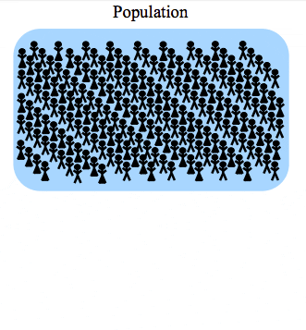
Statistical foundations
When we want to make observations about the data we are analyzing, we often, if not always, turn to statistics in some fashion.
The data we have is referred to as the sample, which was observed from (and is a subset of) the population.
Two broad categories of statistics are descriptive and inferential statistics.
Notes:
With descriptive statistics, as the name implies, we are looking to describe the sample.
Inferential statistics involves using the sample statistics to infer, or deduce, something about the population, such as the underlying distribution.
Important note
Sample statistics are used as estimators of the population parameters, meaning that we have to quantify their bias and variance. There is a multitude of methods for this; some will make assumptions on the shape of the distribution (parametric) and others won't (non-parametric). This is all well beyond the scope of this course, but it is good to be aware of.
Often, the goal of an analysis is to create a story for the data; unfortunately, it is very easy to misuse statistics. It's the subject of a famous quote:
"There are three kinds of lies: lies, damned lies, and statistics."
— Benjamin Disraeli
This is especially true of inferential statistics, which is used in many scientific studies and papers to show the significance of the researchers' findings. This is a more advanced topic and, since this isn't a statistics course, we will only briefly touch upon some of the tools and principles behind inferential statistics, which can be pursued further. We will focus on descriptive statistics to help explain the data we are analyzing.

Slide 9
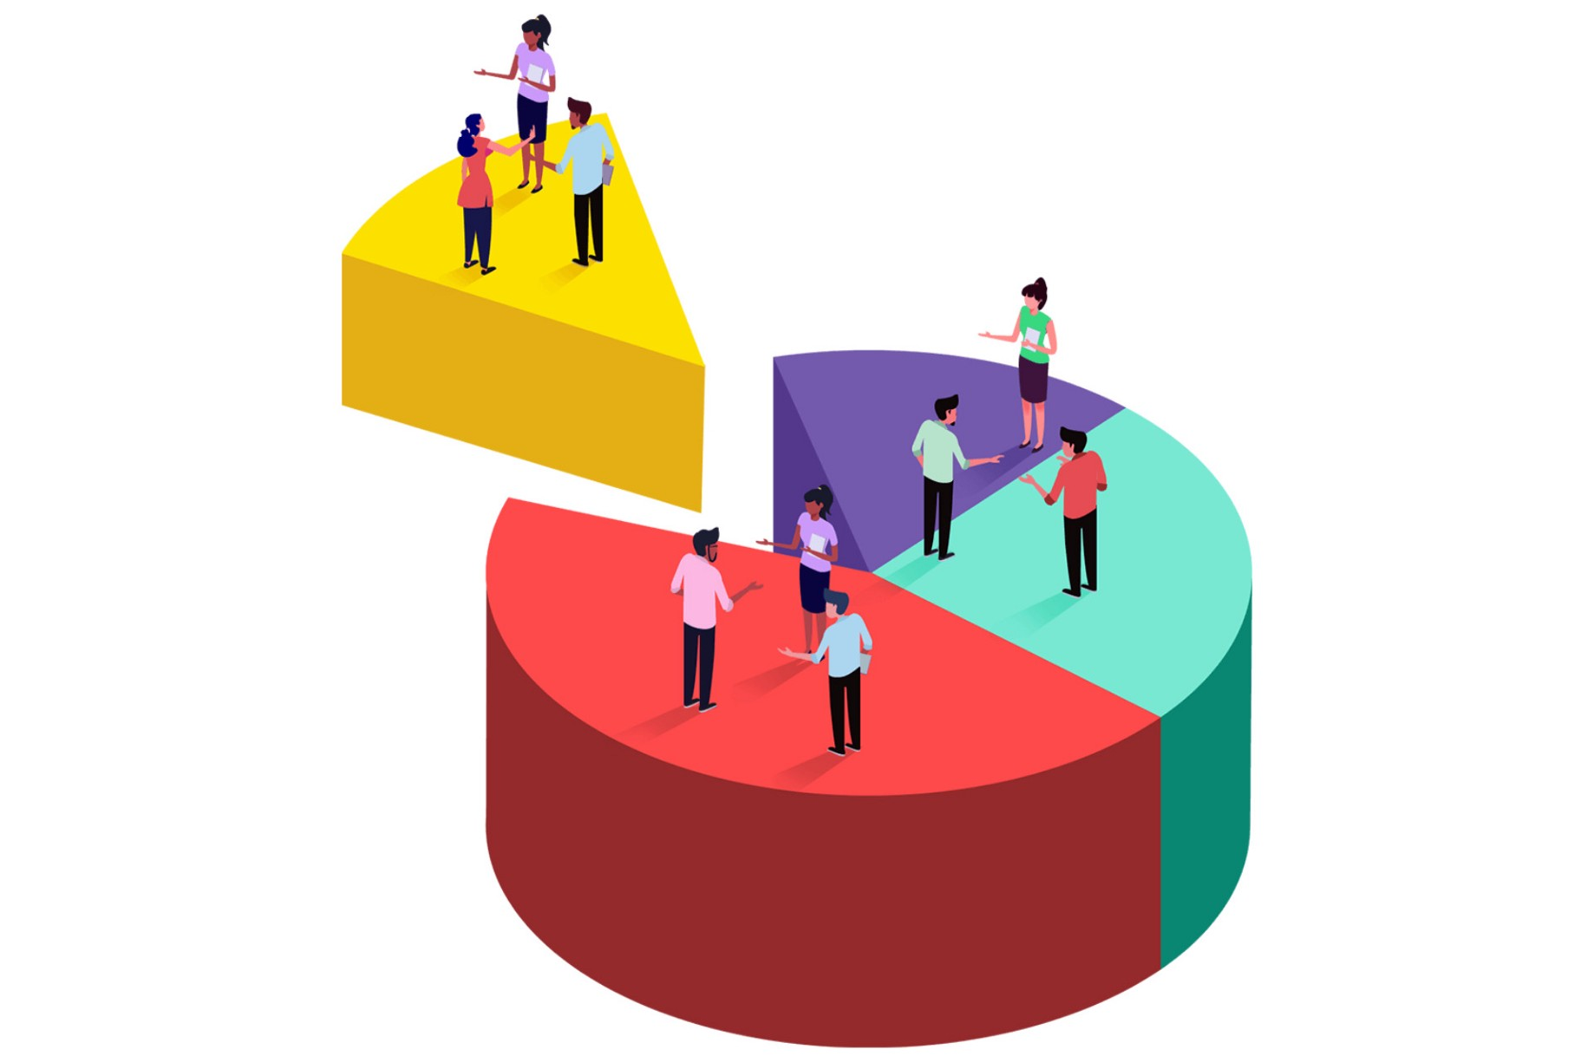

Sampling
There's an important thing to remember before we attempt any analysis: our sample must be a random sample that is representative of the population.
This means that the data must be sampled without bias (for example, if we are asking people whether they like a certain sports team, we can't only ask fans of the team)
We should have (ideally) members of all distinct groups from the population in our sample (in the sports team example, we can't just ask men).
Notes:
When we discuss machine learning in lesson 9, Getting Started with Machine Learning in Python, we will need to sample our data, which will be a sample to begin with. This is called resampling. Depending on the data, we will have to pick a different method of sampling. Often, our best bet is a simple random sample: we use a random number generator to pick rows at random. When we have distinct groups in the data, we want our sample to be a stratified random sample, which will preserve the proportion of the groups in the data. In some cases, we don't have enough data for the aforementioned sampling strategies, so we may turn to random sampling with replacement (bootstrapping); this is called a bootstrap sample. Note that our underlying sample needs to have been a random sample or we risk increasing the bias of the estimator (we could pick certain rows more often because they are in the data more often if it was a convenience sample, while in the true population these rows aren't as prevalent). We will see an example of bootstrapping in lesson 8, Rule-Based Anomaly Detection.
Important note
A thorough discussion of the theory behind bootstrapping and its consequences is well beyond the scope of this course, but watch this video for a primer: https://www.youtube.com/watch?v=gcPIyeqymOU.
You can read more about sampling methods, along with their strengths and weaknesses, at https://www.khanacademy.org/math/statistics-probability/designing-studies/sampling-methods-stats/a/sampling-methods-review.

Slide 10

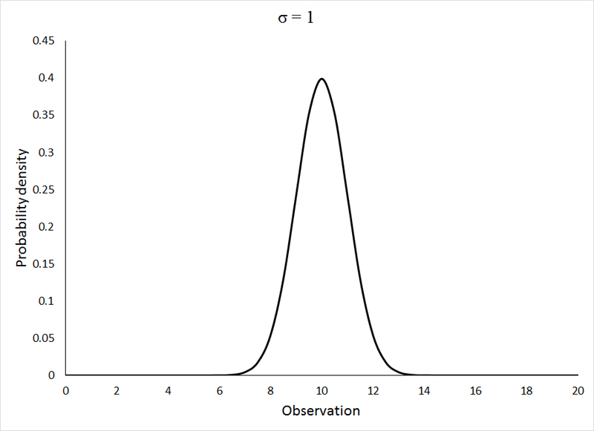
Descriptive statistics
Descriptive statistics are used to describe and/or summarize the data we are working with.
We can start our summarization of the data with a measure of central tendency, which describes where most of the data is centered around, and a measure of spread or dispersion, which indicates how far apart values are.
Notes:
We will begin our discussion of descriptive statistics with univariate statistics; univariate simply means that these statistics are calculated from one (uni) variable. Everything in this section can be extended to the whole dataset, but the statistics will be calculated per variable we are recording (meaning that if we had 100 observations of speed and distance pairs, we could calculate the averages across the dataset, which would give us the average speed and average distance statistics).

Slide 11
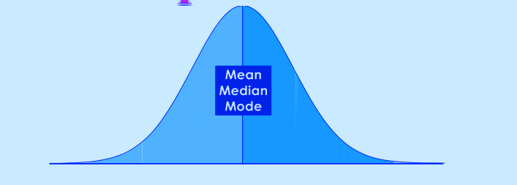
Descriptive statistics
Measures of central tendency
Measures of central tendency describe the center of our distribution of data.
There are three common statistics that are used as measures of center: mean, median, and mode.
Each has its own strengths, depending on the data we are working with.

Slide 12
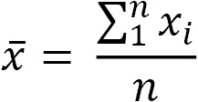
Descriptive statistics
Mean
Perhaps the most common statistic for summarizing data is the average, or mean.
The population mean is denoted by μ (the Greek letter mu), and the sample mean is written as (pronounced X-bar).
The sample mean is calculated by summing all the values and dividing by the count of values; for example, the mean of the numbers 0, 1, 1, 2, and 9 is 2.6 ((0 + 1 + 1 + 2 + 9)/5):
Notes:
We use xi to represent the ith observation of the variable X. Note how the variable as a whole is represented with a capital letter, while the specific observation is lowercase. Σ (the Greek capital letter sigma) is used to represent a summation, which, in the equation for the mean, goes from 1 to n, which is the number of observations.
One important thing to note about the mean is that it is very sensitive to outliers (values created by a different generative process than our distribution). In the previous example, we were dealing with only five values; nevertheless, the 9 is much larger than the other numbers and pulled the mean higher than all but the 9. In cases where we suspect outliers to be present in our data, we may want to instead use the median as our measure of central tendency.

Slide 13
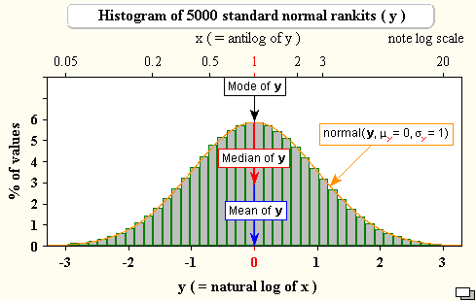
Descriptive statistics
Median
Unlike the mean, the median is robust to outliers.
Consider income in the US; the top 1% is much higher than the rest of the population, so this will skew the mean to be higher and distort the perception of the average person's income.
However, the median will be more representative of the average income because it is the 50th percentile of our data; this means that 50% of the values are greater than the median and 50% are less than the median.
Notes:
Tip
The ith percentile is the value at which i% of the observations are less than that value, so the 99th percentile is the value in X where 99% of the x's are less than it.
The median is calculated by taking the middle value from an ordered list of values; in cases where we have an even number of values, we take the mean of the middle two values. If we take the numbers 0, 1, 1, 2, and 9 again, our median is 1. Notice that the mean and median for this dataset are different; however, depending on the distribution of the data, they may be the same.

Slide 14
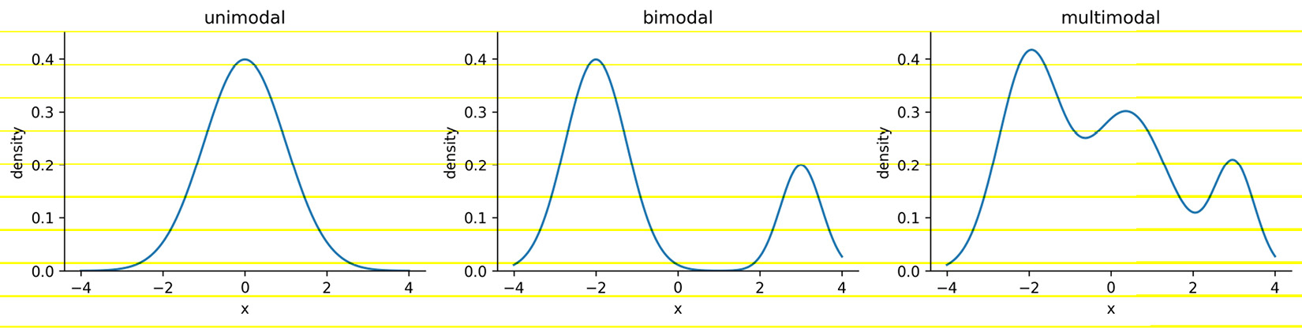
Descriptive statistics
Mode
The mode is the most common value in the data (if we, once again, have the numbers 0, 1, 1, 2, and 9, then 1 is the mode).
Notes:
In practice, we will often hear things such as the distribution is bimodal or multimodal (as opposed to unimodal) in cases where the distribution has two or more most popular values. This doesn't necessarily mean that each of them occurred the same amount of times, but rather, they are more common than the other values by a significant amount. As shown in the following plots, a unimodal distribution has only one mode (at 0), a bimodal distribution has two (at -2 and 3), and a multimodal distribution has many (at -2, 0.4, and 3):
Understanding the concept of the mode comes in handy when describing continuous distributions; however, most of the time when we're describing our continuous data, we will use either the mean or the median as our measure of central tendency. When working with categorical data, on the other hand, we will typically use the mode.

Slide 15
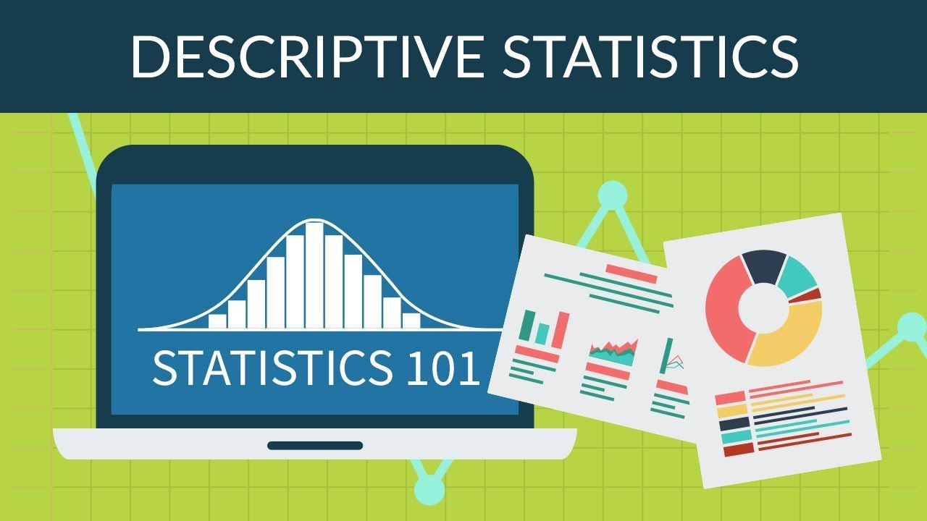
Descriptive statistics
Measures of spread
Knowing where the center of the distribution is only gets us partially to being able to summarize the distribution of our data—we need to know how values fall around the center and how far apart they are.
Notes:
Measures of spread tell us how the data is dispersed; this will indicate how thin (low dispersion) or wide (very spread out) our distribution is. As with measures of central tendency, we have several ways to describe the spread of a distribution, and which one we choose will depend on the situation and the data.

Slide 16
Descriptive statistics
Range
The range is the distance between the smallest value (minimum) and the largest value (maximum).
The units of the range will be the same units as our data.
Notes:
Therefore, unless two distributions of data are in the same units and measuring the same thing, we can't compare their ranges and say one is more dispersed than the other:
Just from the definition of the range, we can see why it wouldn't always be the best way to measure the spread of our data. It gives us upper and lower bounds on what we have in the data; however, if we have any outliers in our data, the range will be rendered useless.
Another problem with the range is that it doesn't tell us how the data is dispersed around its center; it really only tells us how dispersed the entire dataset is. This brings us to the variance.

Slide 17
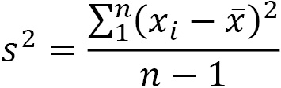
Descriptive statistics
Variance
The variance describes how far apart observations are spread out from their average value (the mean).
The population variance is denoted as σ2 (pronounced sigma-squared), and the sample variance is written as s2.
It is calculated as the average squared distance from the mean.
Notes:
Note that the distances must be squared so that distances below the mean don't cancel out those above the mean.
If we want the sample variance to be an unbiased estimator of the population variance, we divide by n - 1 instead of n to account for using the sample mean instead of the population mean; this is called Bessel's correction (https://en.wikipedia.org/wiki/Bessel%27s_correction). Most statistical tools will give us the sample variance by default, since it is very rare that we would have data for the entire population:
The variance gives us a statistic with squared units. This means that if we started with data on income in dollars ($), then our variance would be in dollars squared ($2). This isn't really useful when we're trying to see how this describes the data; we can use the magnitude (size) itself to see how spread out something is (large values = large spread), but beyond that, we need a measure of spread with units that are the same as our data. For this purpose, we use the standard deviation.

Slide 18
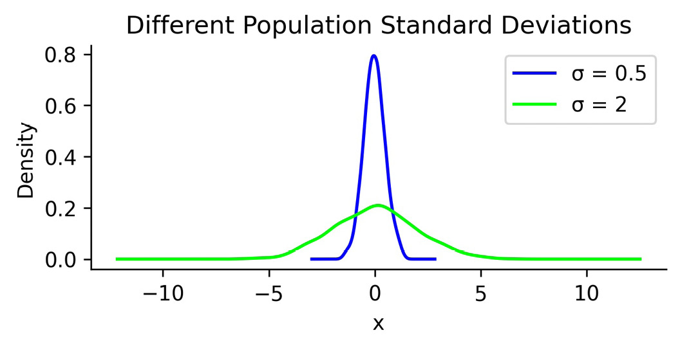
Descriptive statistics
Standard deviation
We can use the standard deviation to see how far from the mean data points are on average.
A small standard deviation means that values are close to the mean, while a large standard deviation means that values are dispersed more widely.
Notes:
This is tied to how we would imagine the distribution curve: the smaller the standard deviation, the thinner the peak of the curve (0.5); the larger the standard deviation, the wider the peak of the curve (2):

Slide 19

Prediction and forecasting
The regression line in the previous scatter plot yields the following equation for the relationship:
Notes:
Suppose that today the temperature is 35°C—we would plug that in for temperature in the equation. The result predicts that the ice cream shop will sell 24.54 ice creams. This prediction is along the red line in the previous plot. Note that the ice cream shop can't actually sell fractions of ice cream.
Before leaving the model in the hands of the ice cream shop, it's important to discuss the difference between the dotted and solid portions of the regression line that we obtained. When we make predictions using the solid portion of the line, we are using interpolation, meaning that we will be predicting ice cream sales for temperatures the regression was created on. On the other hand, if we try to predict how many ice creams will be sold at 45°C, it is called extrapolation (the dotted portion of the line), since we didn't have any temperatures this high when we ran the regression. Extrapolation can be very dangerous as many trends don't continue indefinitely. People may decide not to leave their houses because it is so hot. This means that instead of selling the predicted 39.54 ice creams, they would sell zero.
When working with time series, our terminology is a little different: we often look to forecast future values based on past values. Forecasting is a type of prediction for time series. Before we try to model the time series, however, we will often use a process called time series decomposition to split the time series into components, which can be combined in an additive or multiplicative fashion and may be used as parts of a model.
The trend component describes the behavior of the time series in the long term without accounting for seasonal or cyclical effects. Using the trend, we can make broad statements about the time series in the long run, such as the population of Earth is increasing or the value of a stock is stagnating. The seasonality component explains the systematic and calendar-related movements of a time series. For example, the number of ice cream trucks on the streets of New York City is high in the summer and drops to nothing in the winter; this pattern repeats every year, regardless of whether the actual amount each summer is the same. Lastly, the cyclical component accounts for anything else unexplained or irregular with the time series; this could be something such as a hurricane driving the number of ice cream trucks down in the short term because it isn't safe to be outside. This component is difficult to anticipate with a forecast due to its unexpected nature.

Slide 20
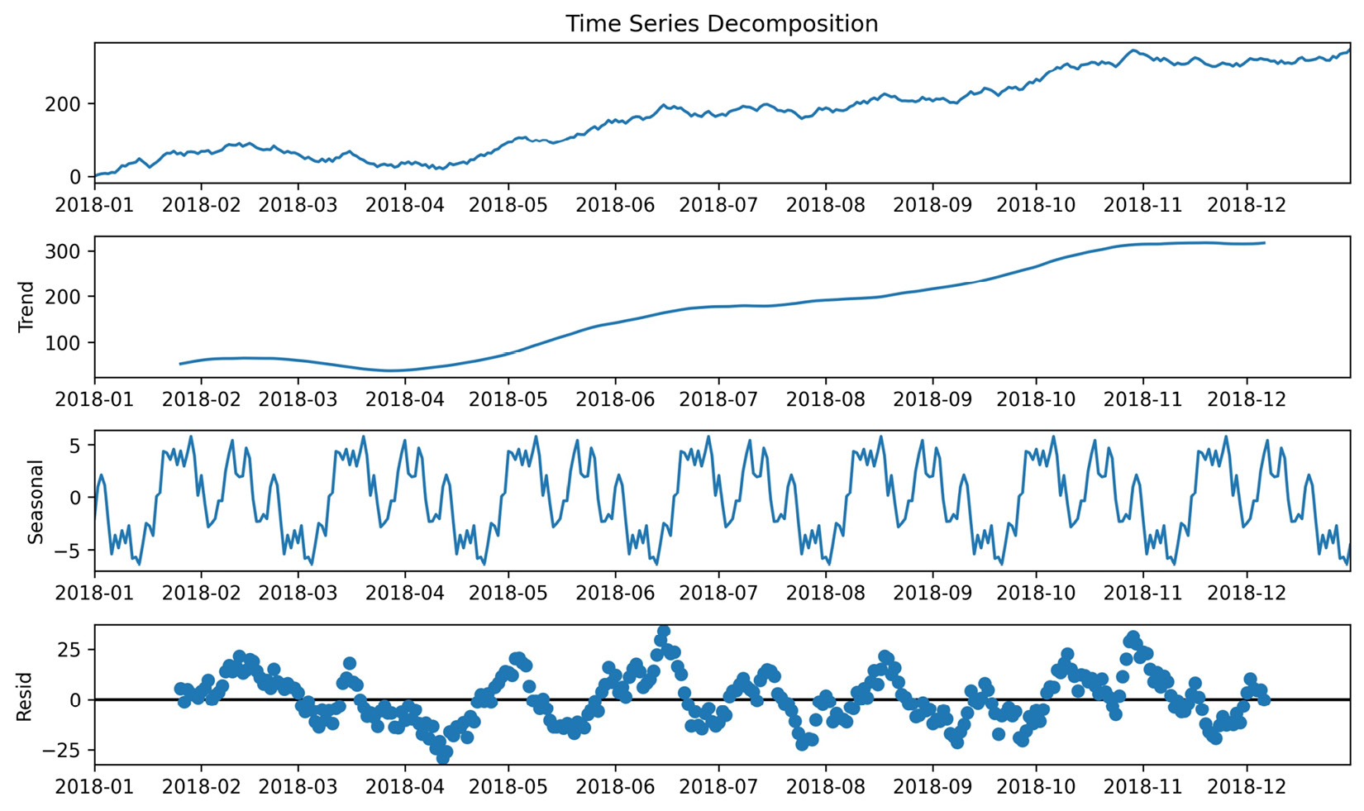
Prediction and forecasting
We can use Python to decompose the time series into trend, seasonality, and noise or residuals.
Notes:
The cyclical component is captured in the noise (random, unpredictable data); after we remove the trend and seasonality from the time series, what we are left with is the residual:
When building models to forecast time series, some common methods include exponential smoothing and ARIMA-family models. ARIMA stands for autoregressive (AR), integrated (I), moving average (MA). Autoregressive models take advantage of the fact that an observation at time t is correlated to a previous observation, for example, at time t - 1. In lesson 5, Visualizing Data with Pandas and Matplotlib, we will look at some techniques for determining whether a time series is autoregressive; note that not all time series are. The integrated component concerns the differenced data, or the change in the data from one time to another. For example, if we were concerned with a lag (distance between times) of 1, the differenced data would be the value at time t subtracted by the value at time t - 1. Lastly, the moving average component uses a sliding window to average the last x observations, where x is the length of the sliding window. If, for example, we have a 3-period moving average, by the time we have all of the data up to time 5, our moving average calculation only uses time periods 3, 4, and 5 to forecast time 6. We will build an ARIMA model in lesson 7, Financial Analysis – Bitcoin and the Stock Market.
The moving average puts equal weight on each time period in the past involved in the calculation. In practice, this isn't always a realistic expectation of our data. Sometimes, all past values are important, but they vary in their influence on future data points. For these cases, we can use exponential smoothing, which allows us to put more weight on more recent values and less weight on values further away from what we are predicting.
Note that we aren't limited to predicting numbers; in fact, depending on the data, our predictions could be categorical in nature—things such as determining which flavor of ice cream will sell the most on a given day or whether an email is spam or not. This type of prediction will be introduced in lesson 9, Getting Started with Machine Learning in Python.

Slide 21
Inferential statistics
With an experiment, we are able to directly influence the independent variable and randomly assign subjects to the control and test groups, such as A/B tests (for anything from website redesigns to ad copy).
Notes:
As mentioned earlier, inferential statistics deals with inferring or deducing things from the sample data we have in order to make statements about the population as a whole. When we're looking to state our conclusions, we have to be mindful of whether we conducted an observational study or an experiment. With an observational study, the independent variable is not under the control of the researchers, and so we are observing those taking part in our study (think about studies on smoking—we can't force people to smoke). The fact that we can't control the independent variable means that we cannot conclude causation.
Note that the control group doesn't receive treatment; they can be given a placebo (depending on what the study is). The ideal setup for this is double-blind, where the researchers administering the treatment don't know which treatment is the placebo and also don't know which subject belongs to which group.
Important note
We can often find reference to Bayesian inference and frequentist inference. These are based on two different ways of approaching probability. Frequentist statistics focuses on the frequency of the event, while Bayesian statistics uses a degree of belief when determining the probability of an event. We will see an example of Bayesian statistics in lesson 11, Machine Learning Anomaly Detection. You can read more about how these methods differ at https://www.probabilisticworld.com/frequentist-bayesian-approaches-inferential-statistics/.
Inferential statistics gives us tools to translate our understanding of the sample data to a statement about the population. Remember that the sample statistics we discussed earlier are estimators for the population parameters. Our estimators need confidence intervals, which provide a point estimate and a margin of error around it. This is the range that the true population parameter will be in at a certain confidence level. At the 95% confidence level, 95% of the confidence intervals that are calculated from random samples of the population contain the true population parameter. Frequently, 95% is chosen for the confidence level and other purposes in statistics, although 90% and 99% are also common; the higher the confidence level, the wider the interval.
Hypothesis tests allow us to test whether the true population parameter is less than, greater than, or not equal to some value at a certain significance level (called alpha). The process of performing a hypothesis test starts with stating our initial assumption or null hypothesis: for example, the true population mean is 0. We pick a level of statistical significance, usually 5%, which is the probability of rejecting the null hypothesis when it is true. Then, we calculate the critical value for the test statistic, which will depend on the amount of data we have and the type of statistic (such as the mean of one population or the proportion of votes for a candidate) we are testing. The critical value is compared to the test statistic from our data and, based on the result, we either reject or fail to reject the null hypothesis. Hypothesis tests are closely related to confidence intervals. The significance level is equivalent to 1 minus the confidence level. This means that a result is statistically significant if the null hypothesis value is not in the confidence interval.
Important note
There are many things we have to be aware of when picking the method to calculate a confidence interval or the proper test statistic for a hypothesis test. This is beyond the scope of this course, but check out the link in the Further reading section at the end of this lesson for more information. Also, be sure to look at some of the mishaps with the p-values used in hypothesis testing, such as p-hacking, at https://en.wikipedia.org/wiki/Misuse_of_p-values.
Now that we have an overview of statistics and data analysis, we are ready to get started with the Python portion of this course. Let's start by setting up a virtual environment.

Slide 22
Summary
In this lesson, we learned about the main processes in conducting data analysis: data collection, data wrangling, EDA, and drawing conclusions.
We followed that up with an overview of descriptive statistics and learned how to describe the central tendency and spread of our data; how to summarize it both numerically and visually using the 5-number summary, box plots, histograms, and kernel density estimates
How to scale our data; and how to quantify relationships between variables in our dataset.
Notes:
We got an introduction to prediction and time series analysis. Then, we had a very brief overview of some core topics in inferential statistics that can be explored after mastering the contents of this course. Note that while all the examples in this lesson were of one or two variables, real-life data is often high-dimensional. lesson 10, Making Better Predictions – Optimizing Models, will touch on some ways to address this. Lastly, we set up our virtual environment for this course and learned how to work with Jupyter Notebooks.
Now that we have built a strong foundation, we will start working with data in Python in the next lesson.

Slide 23
"Complete Exercises"

Slide 24
"Complete Lab 1"

